Slide 1
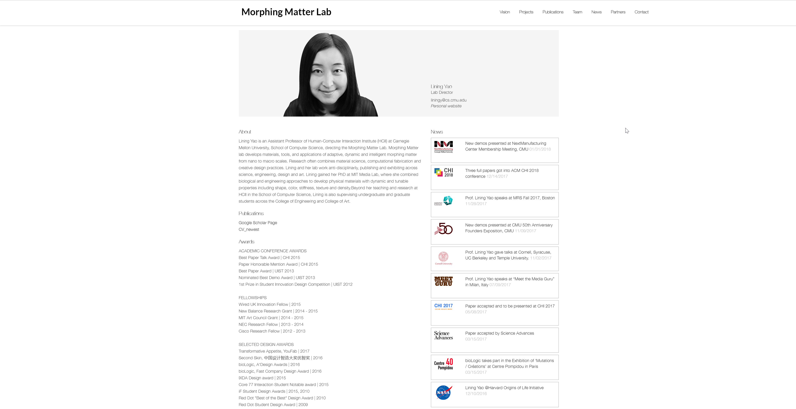
Notes:
http://morphingmatter.cs.cmu.edu/lining-yao/

Slide 2
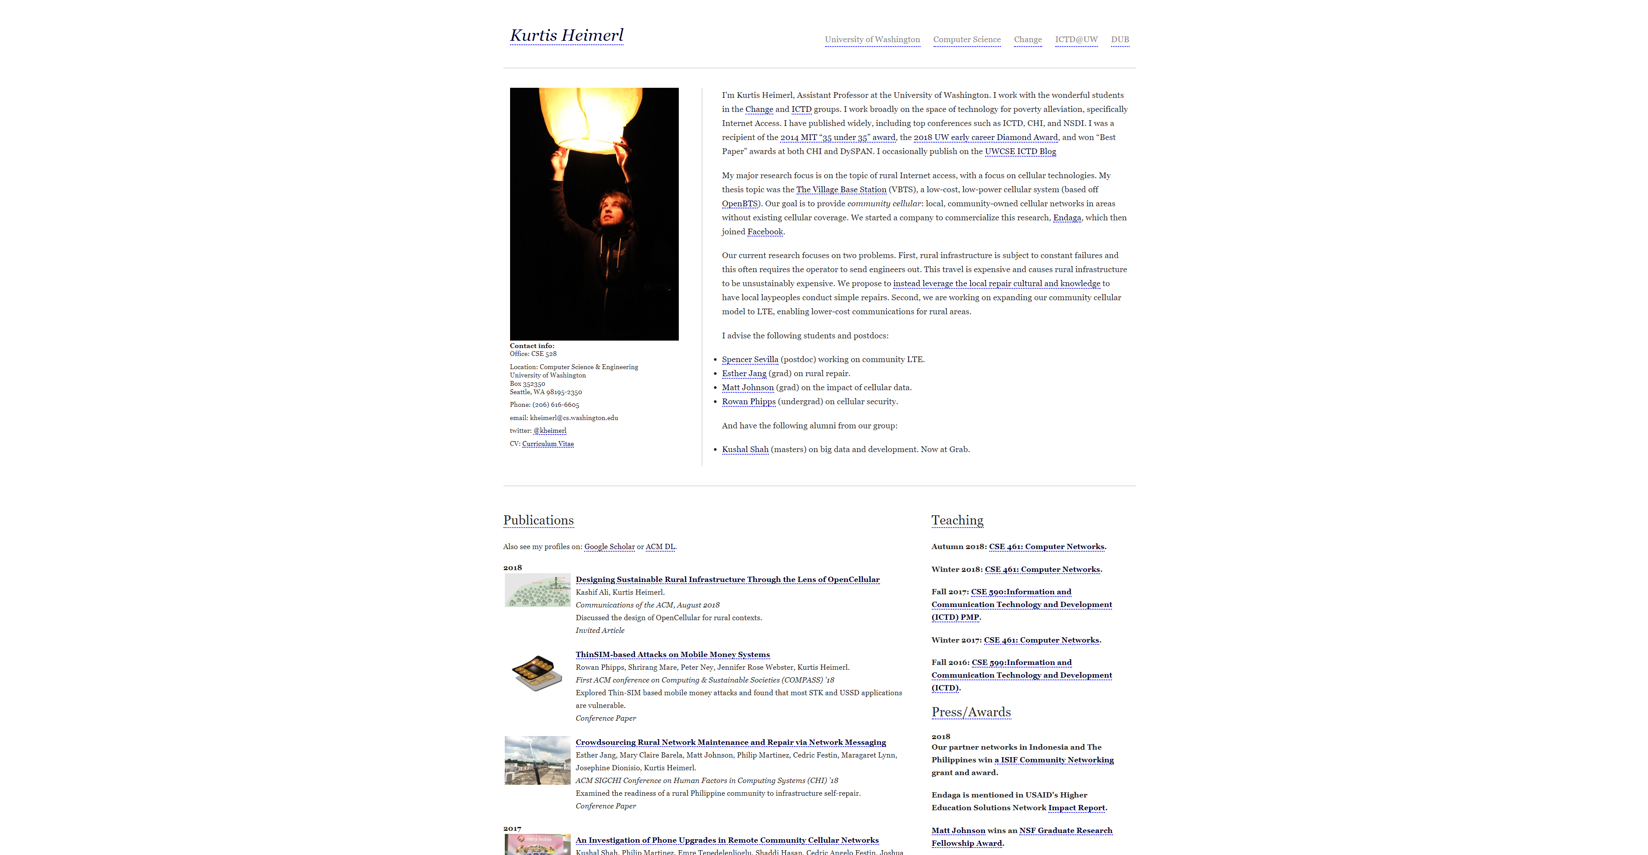

Slide 3
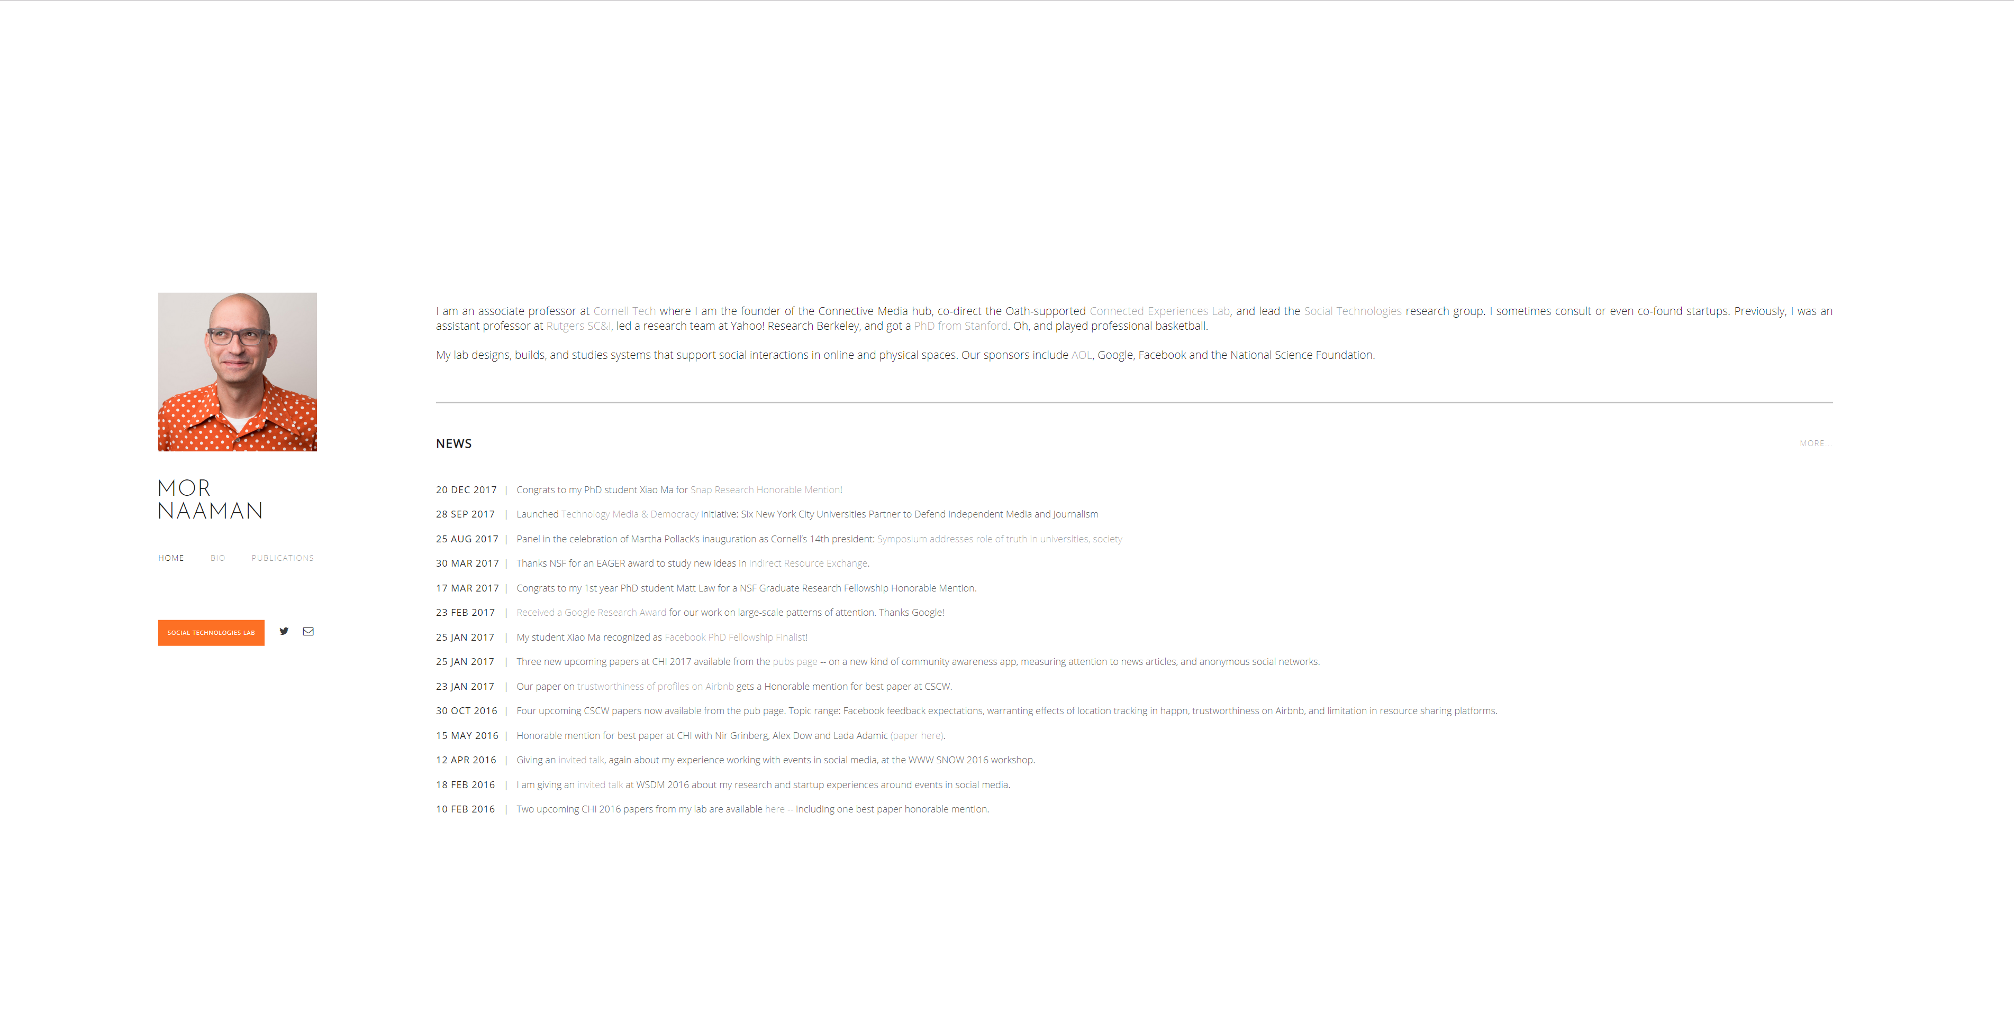
Notes:
https://people.jacobs.cornell.edu/mor/

Slide 4
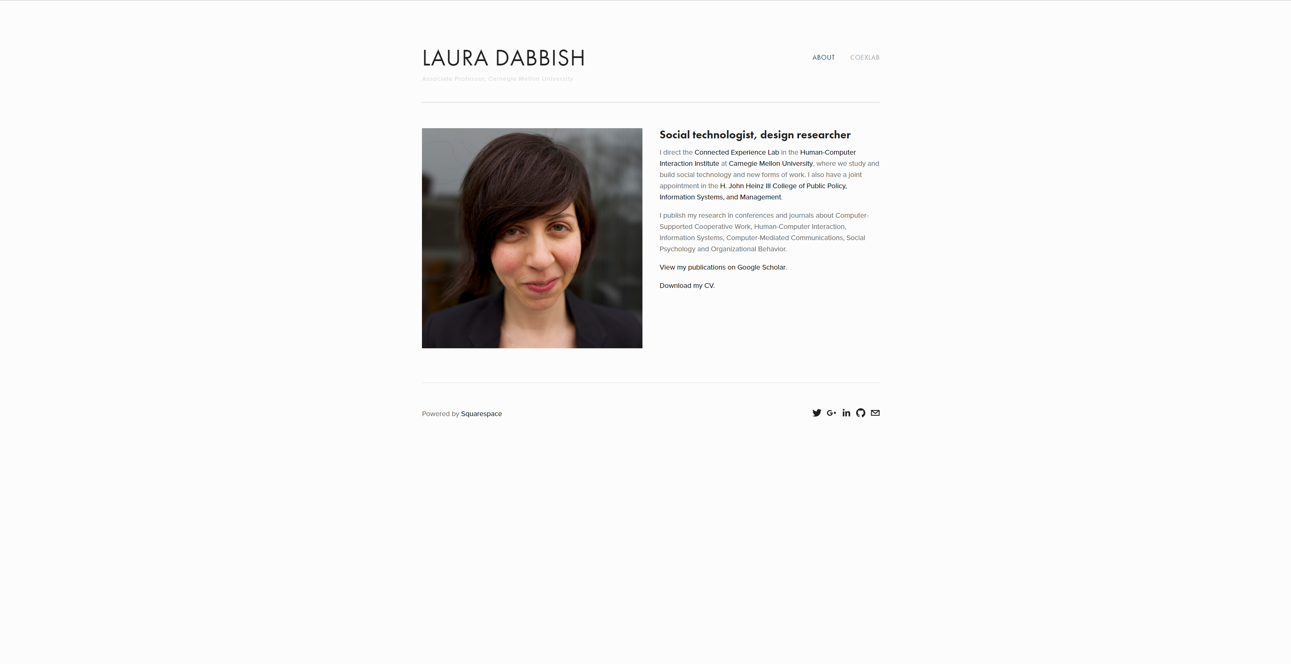
Notes:
http://www.lauradabbish.com/

Slide 5
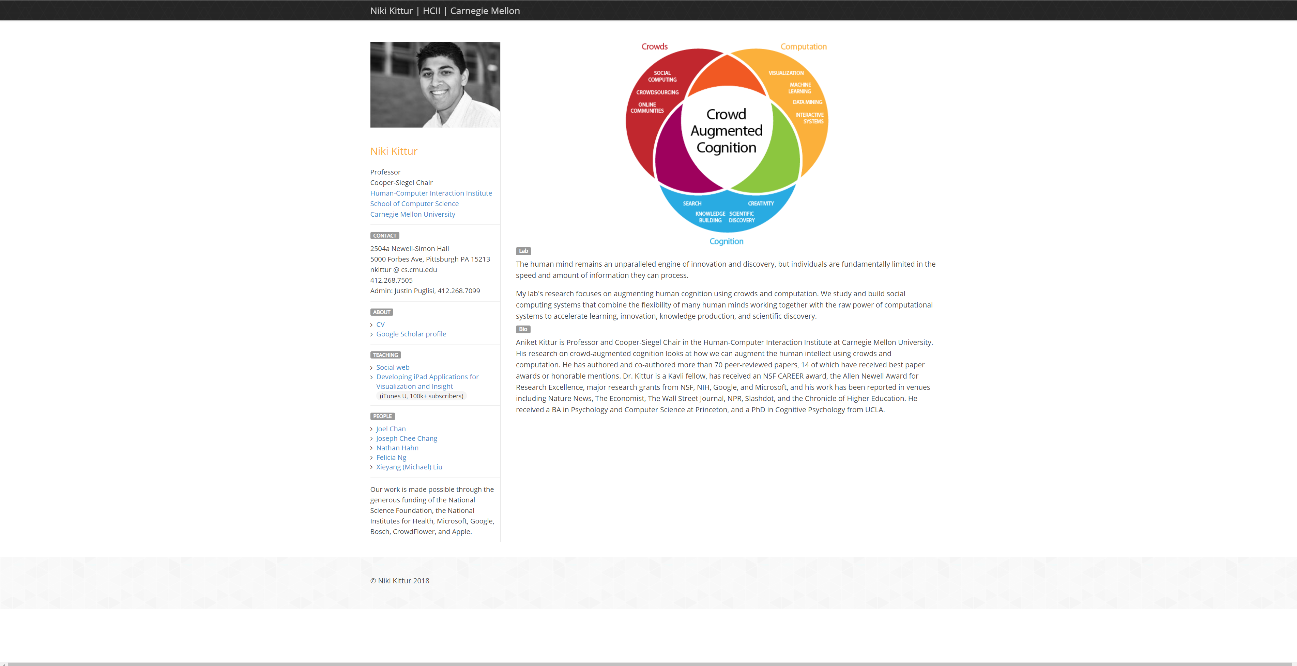
Notes:
http://kittur.org/

Slide 6
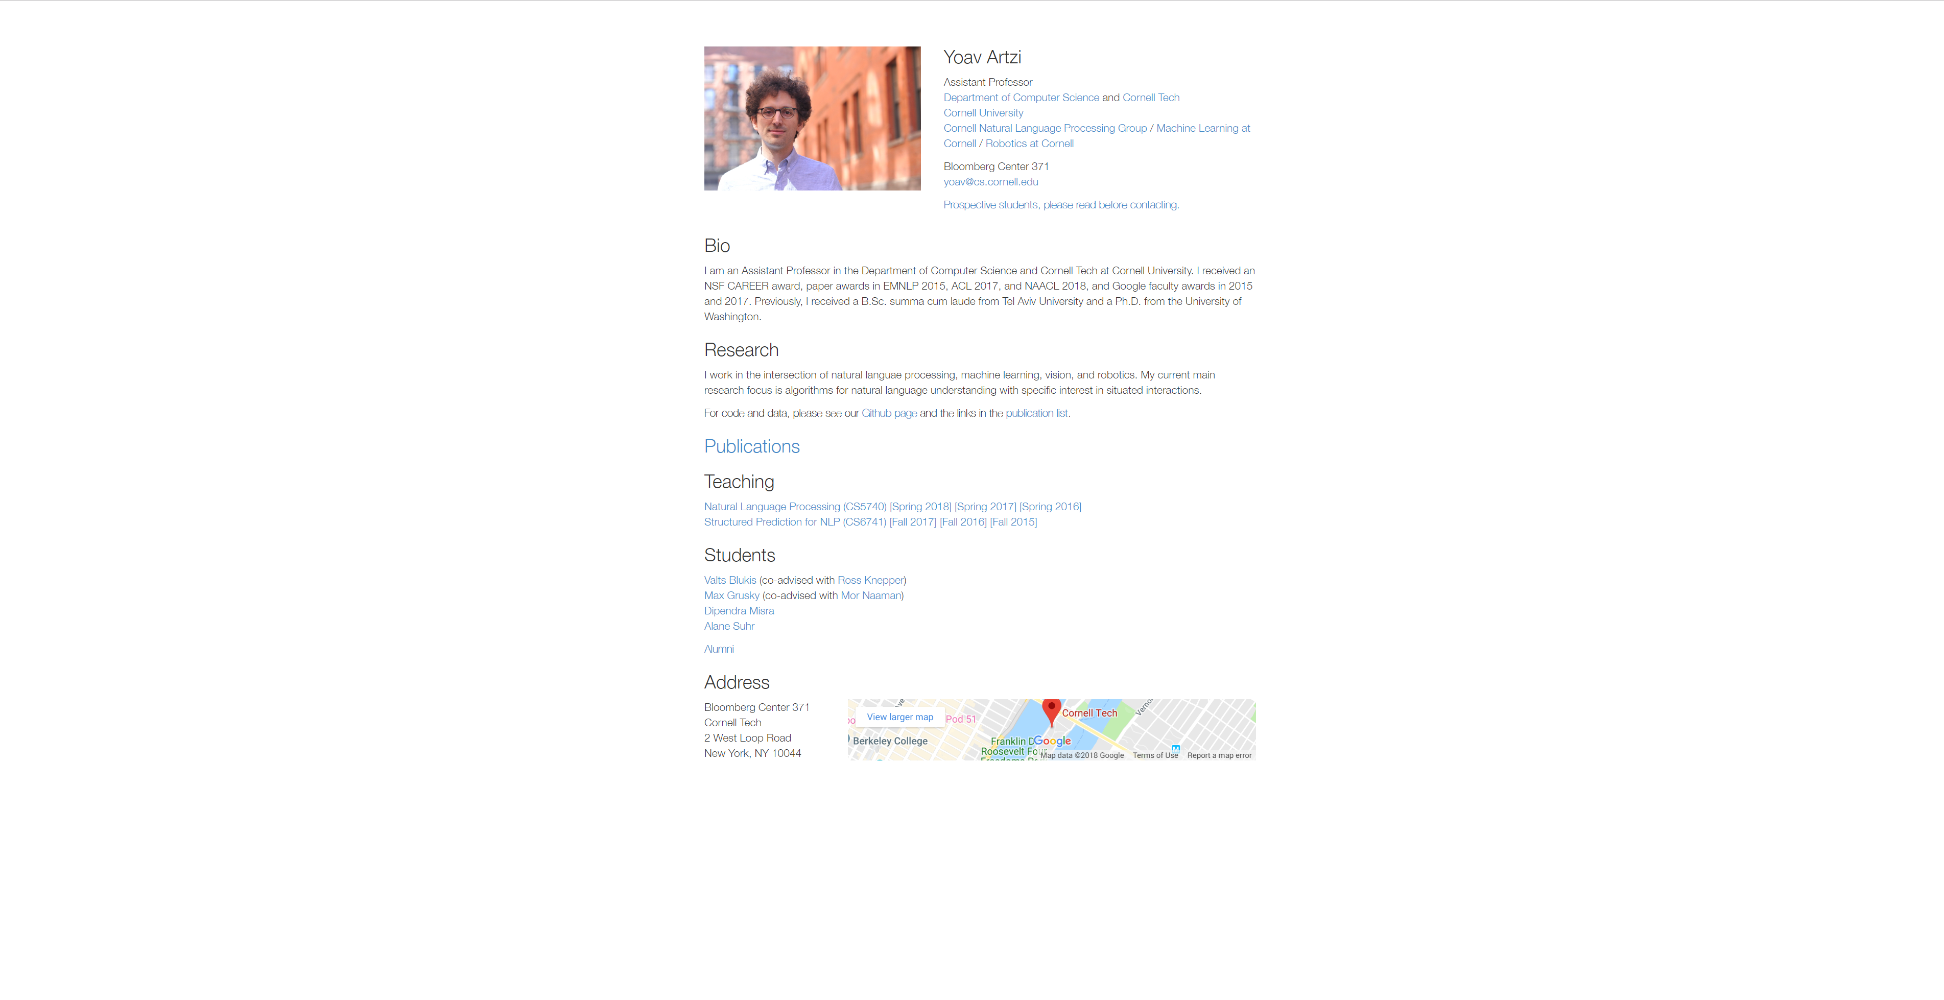

Slide 7
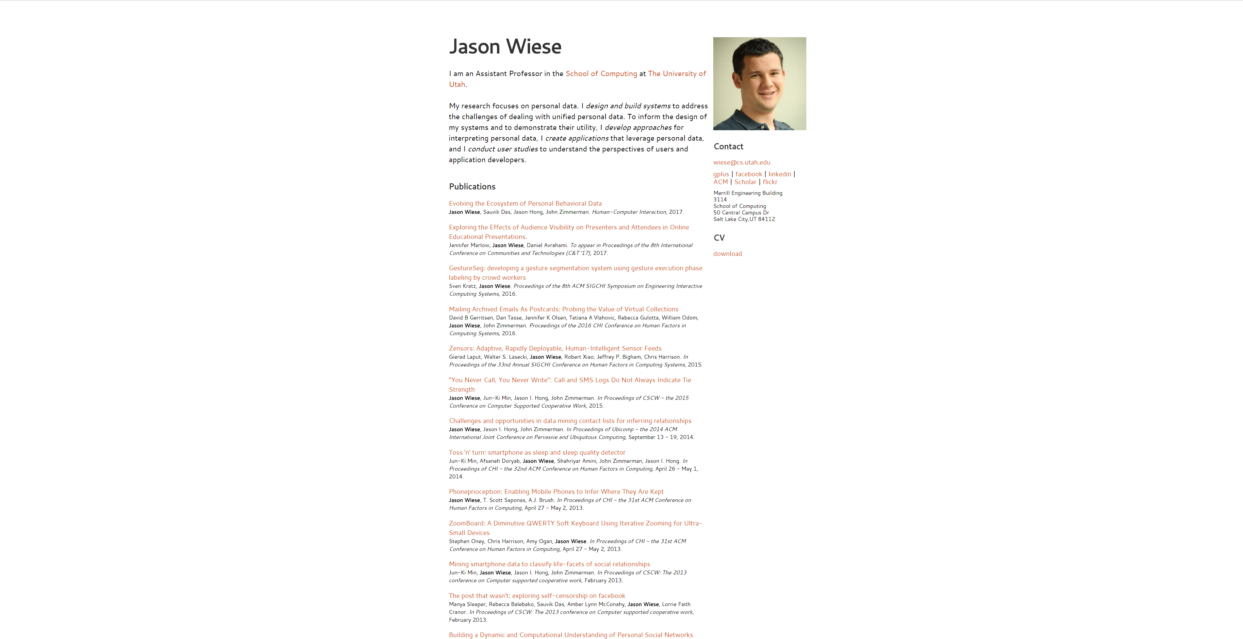

Slide 8
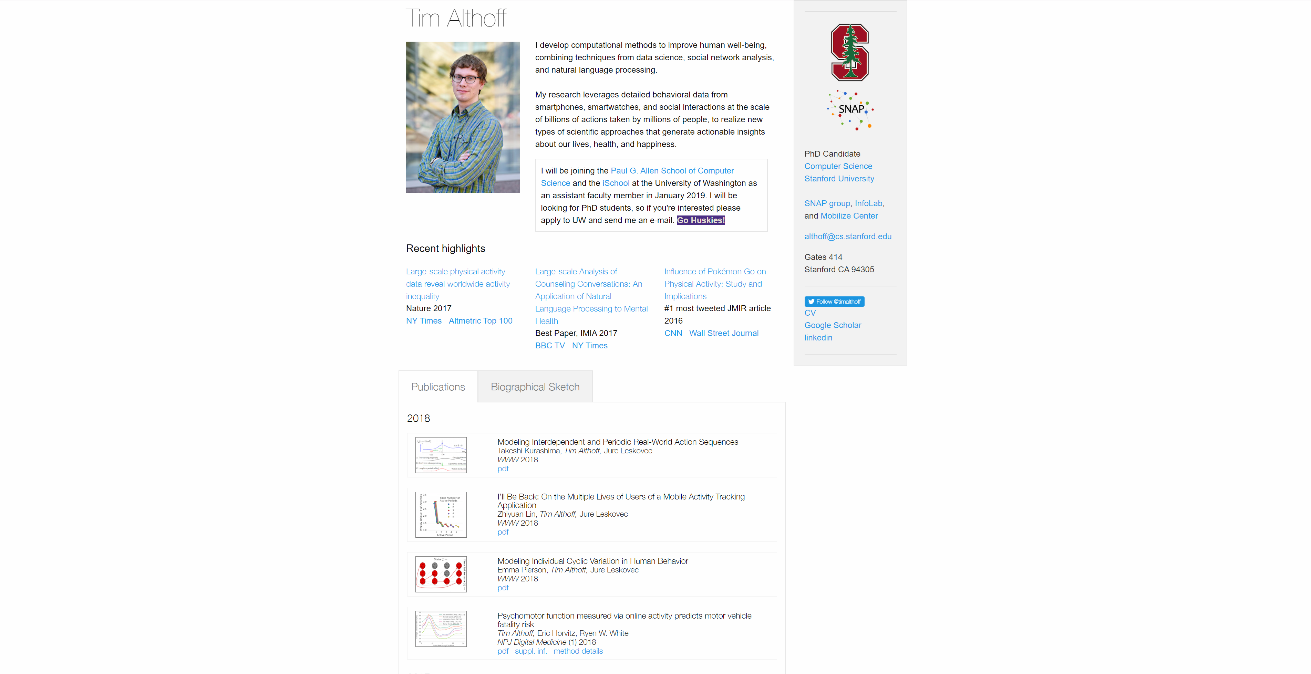
Notes:
http://timalthoff.de/

Slide 9
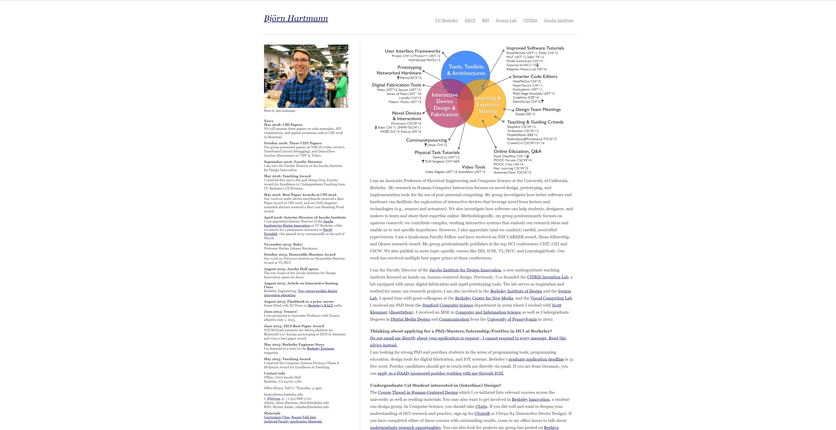

Slide 10
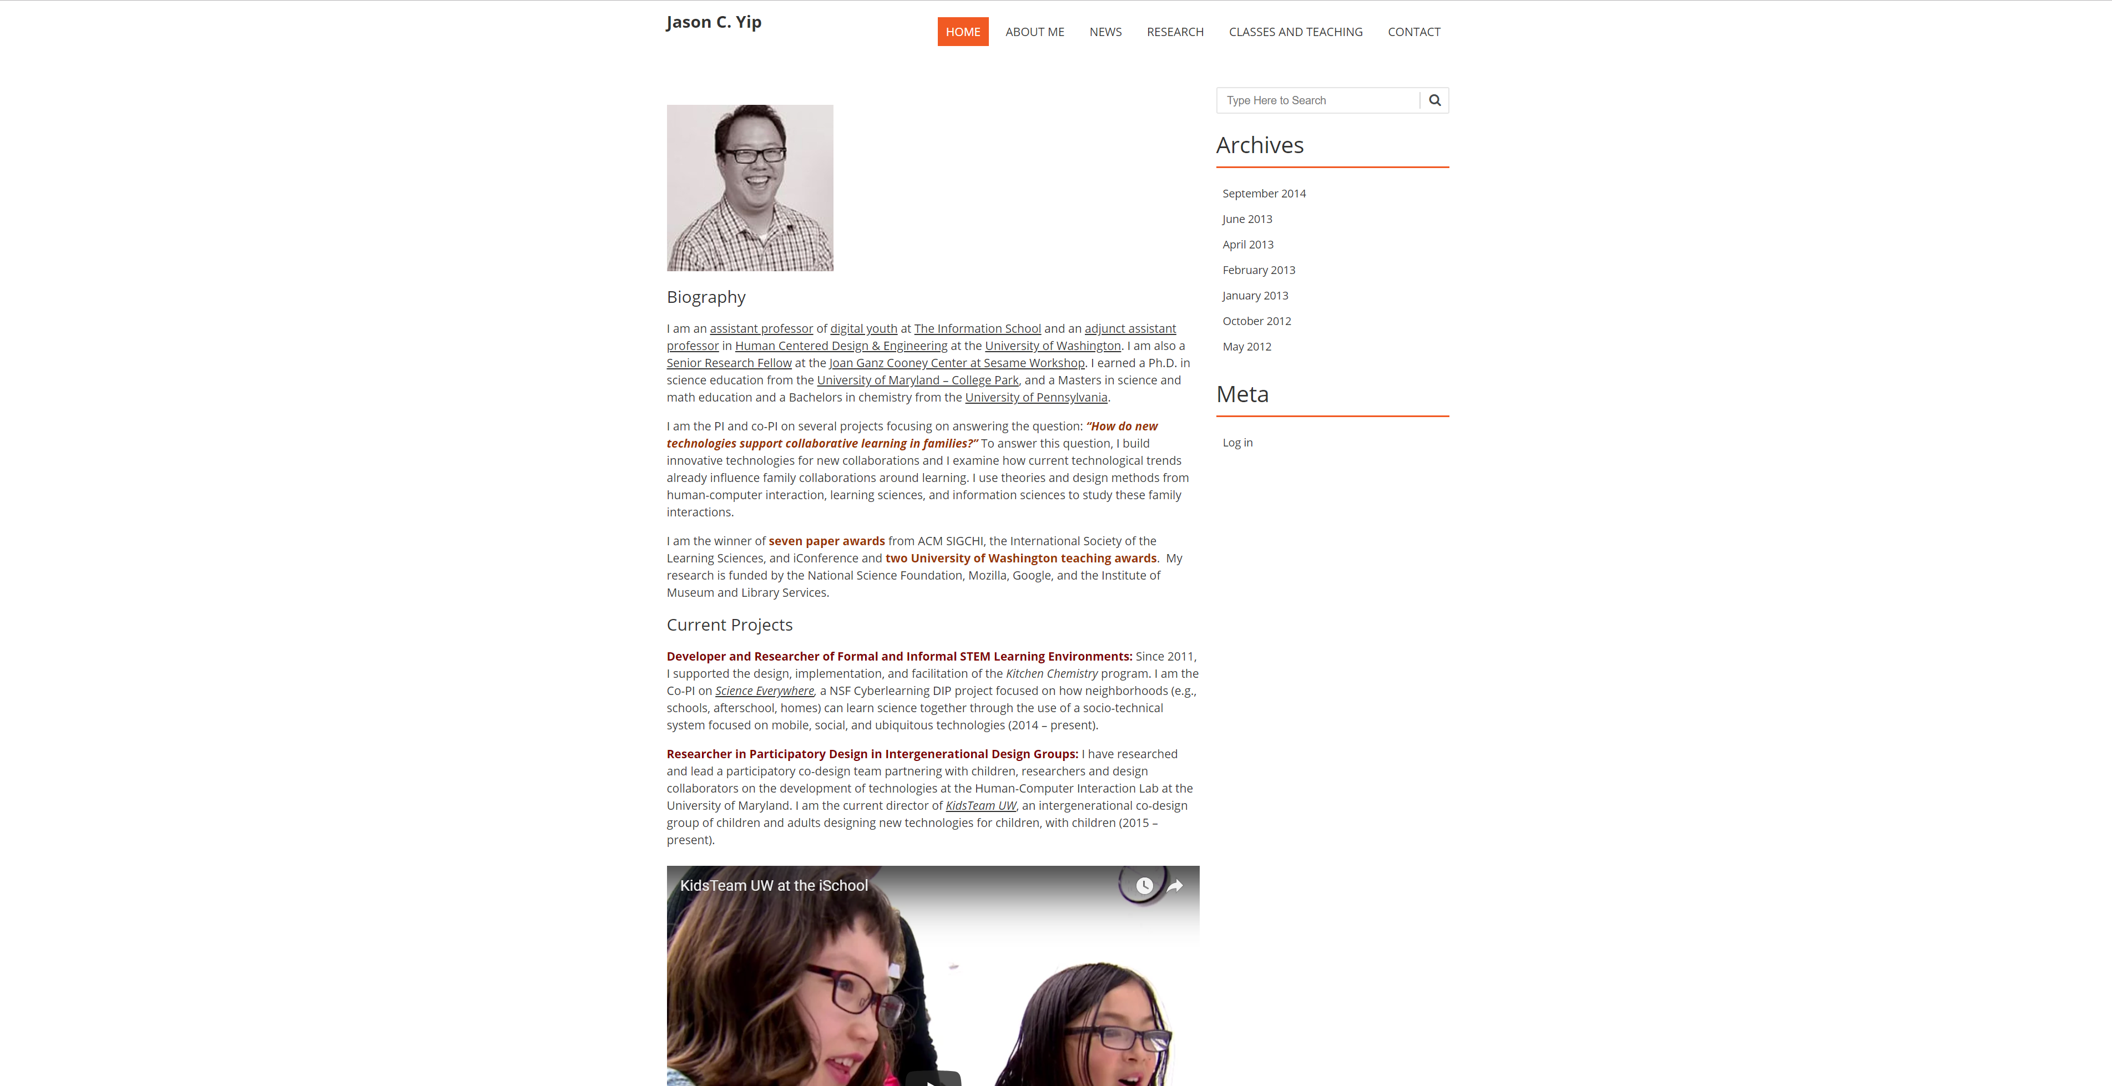

Slide 11
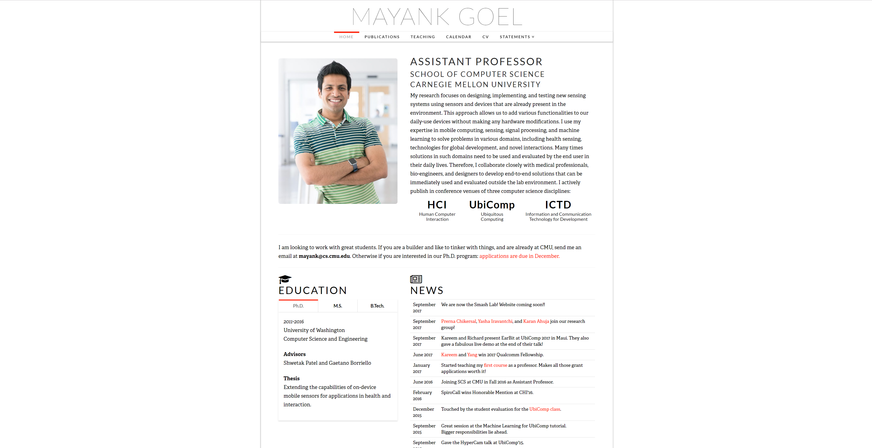
Notes:
http://www.mayankgoel.courses/

Slide 12
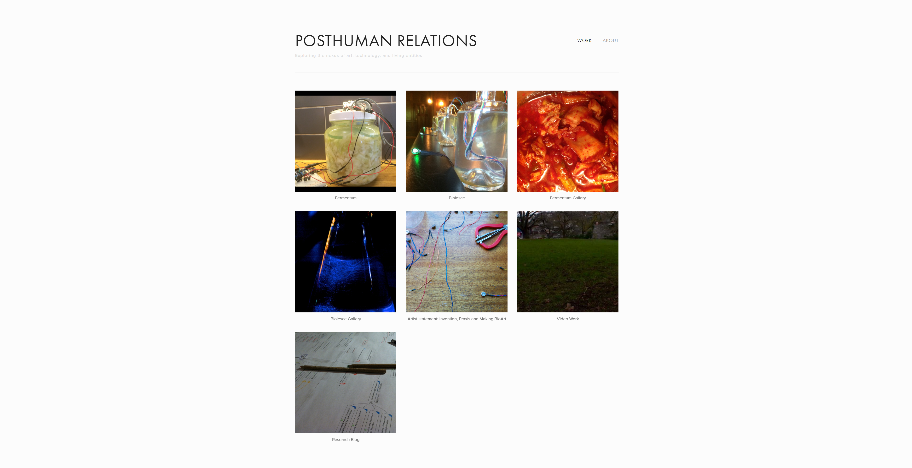
Notes:
Tyler Fox: http://www.tylersfox.com/

Slide 13
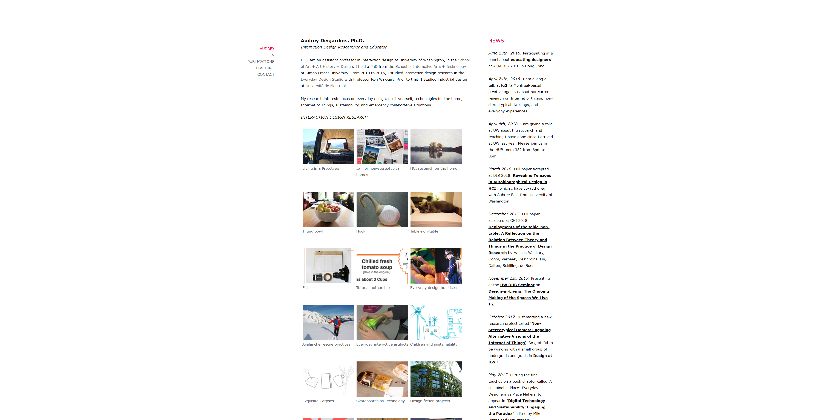

Slide 14
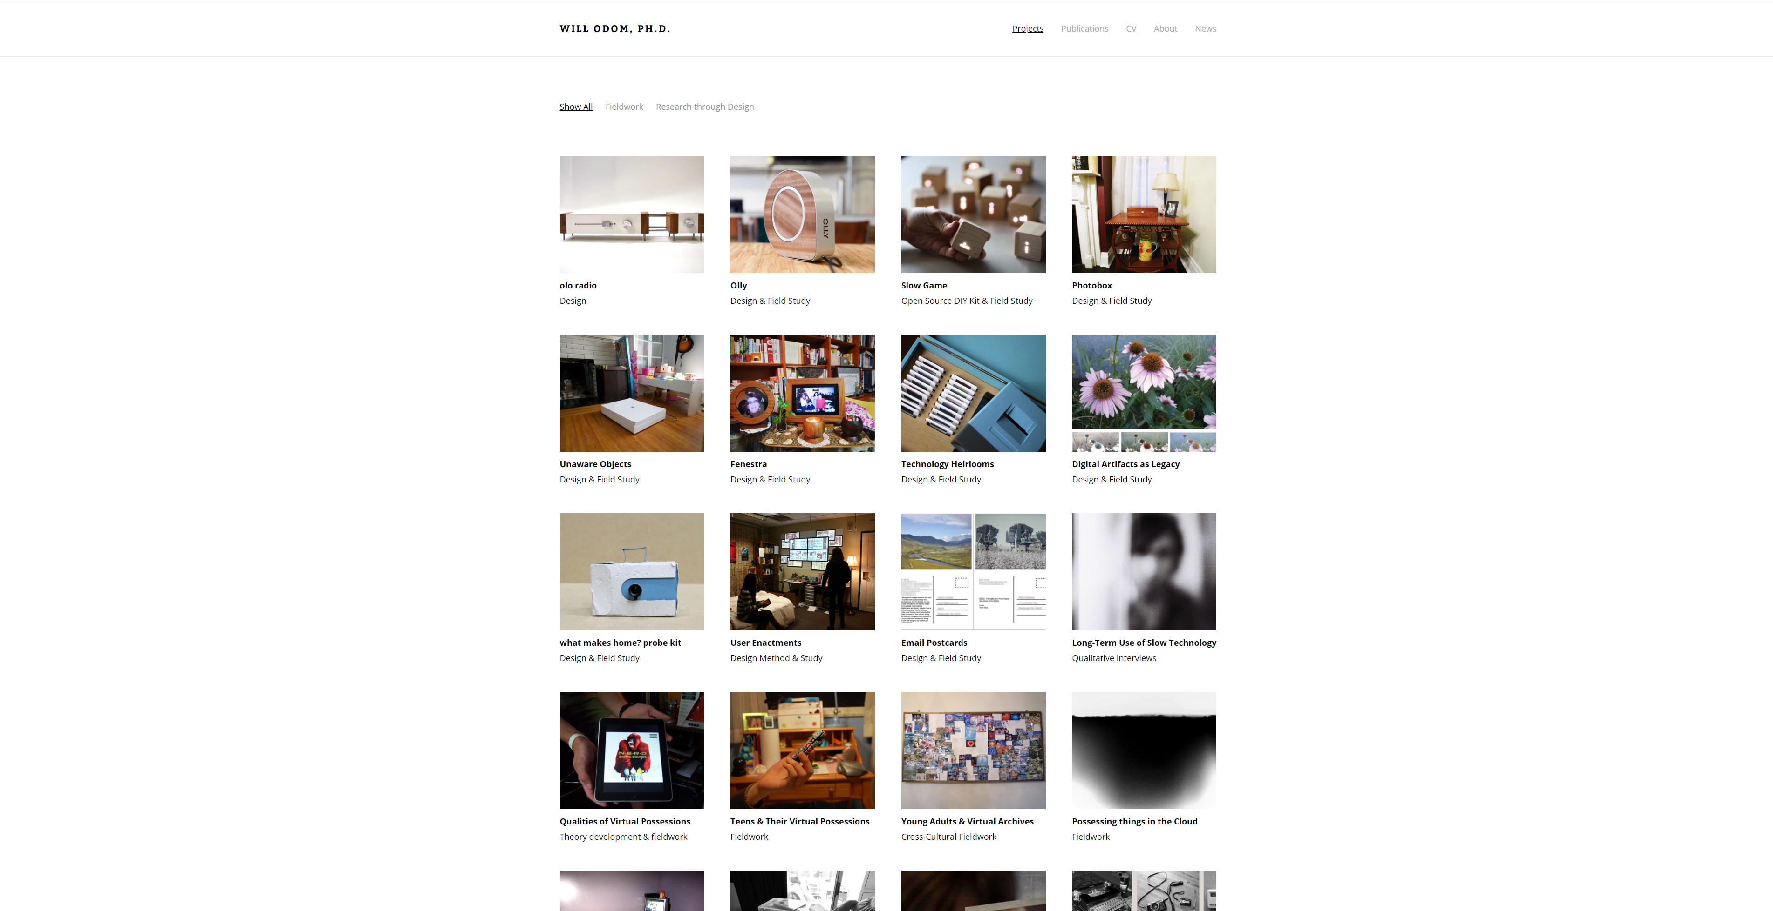
Notes:
http://willodom.com/

Slide 15
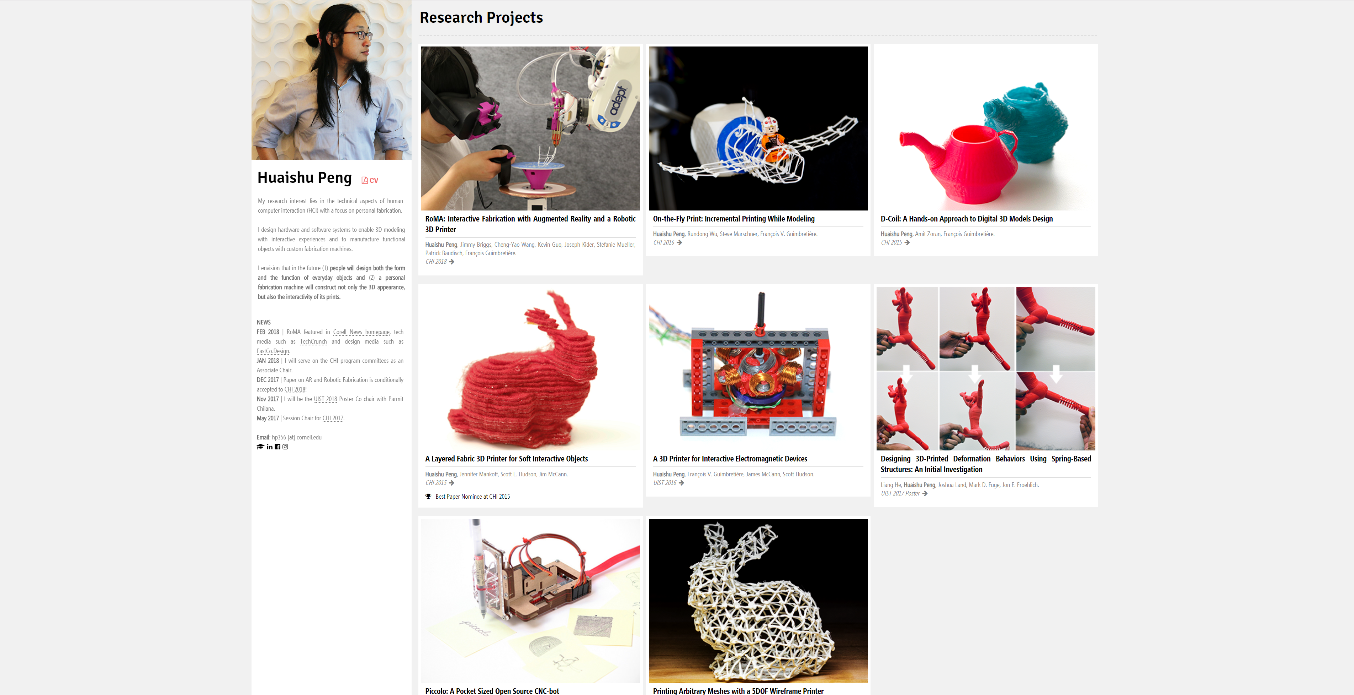

Slide 16
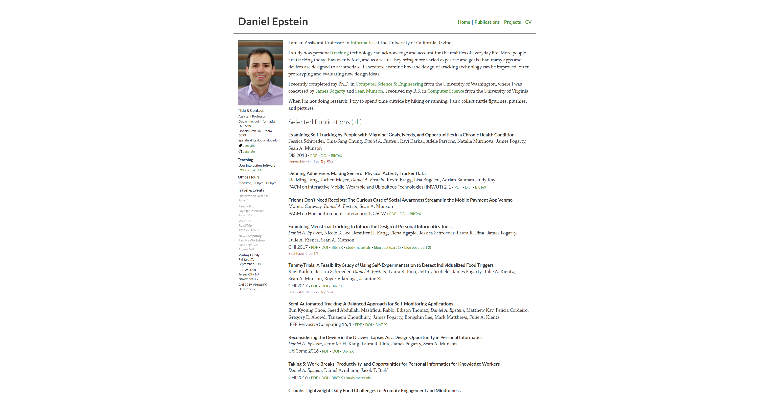

Slide 17
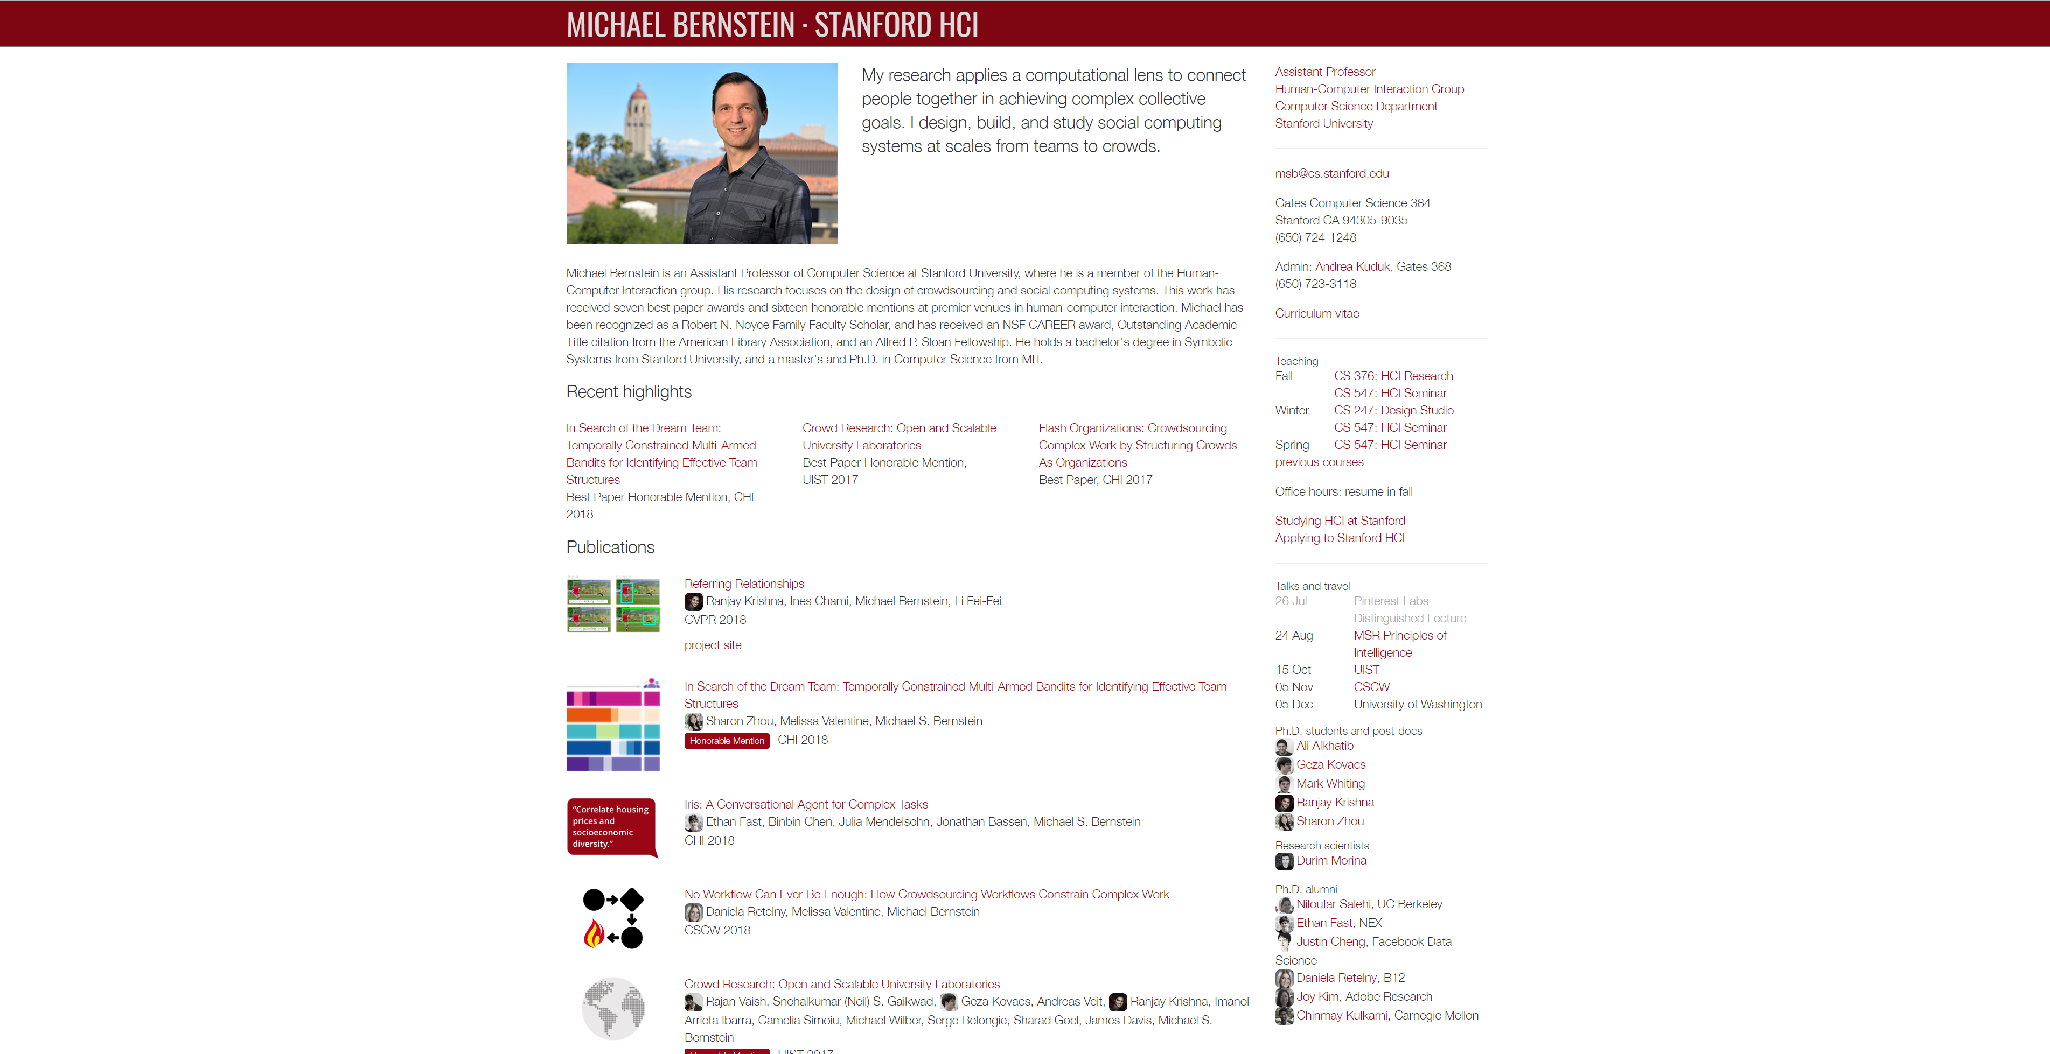
Notes:
http://hci.stanford.edu/msb/

Slide 18
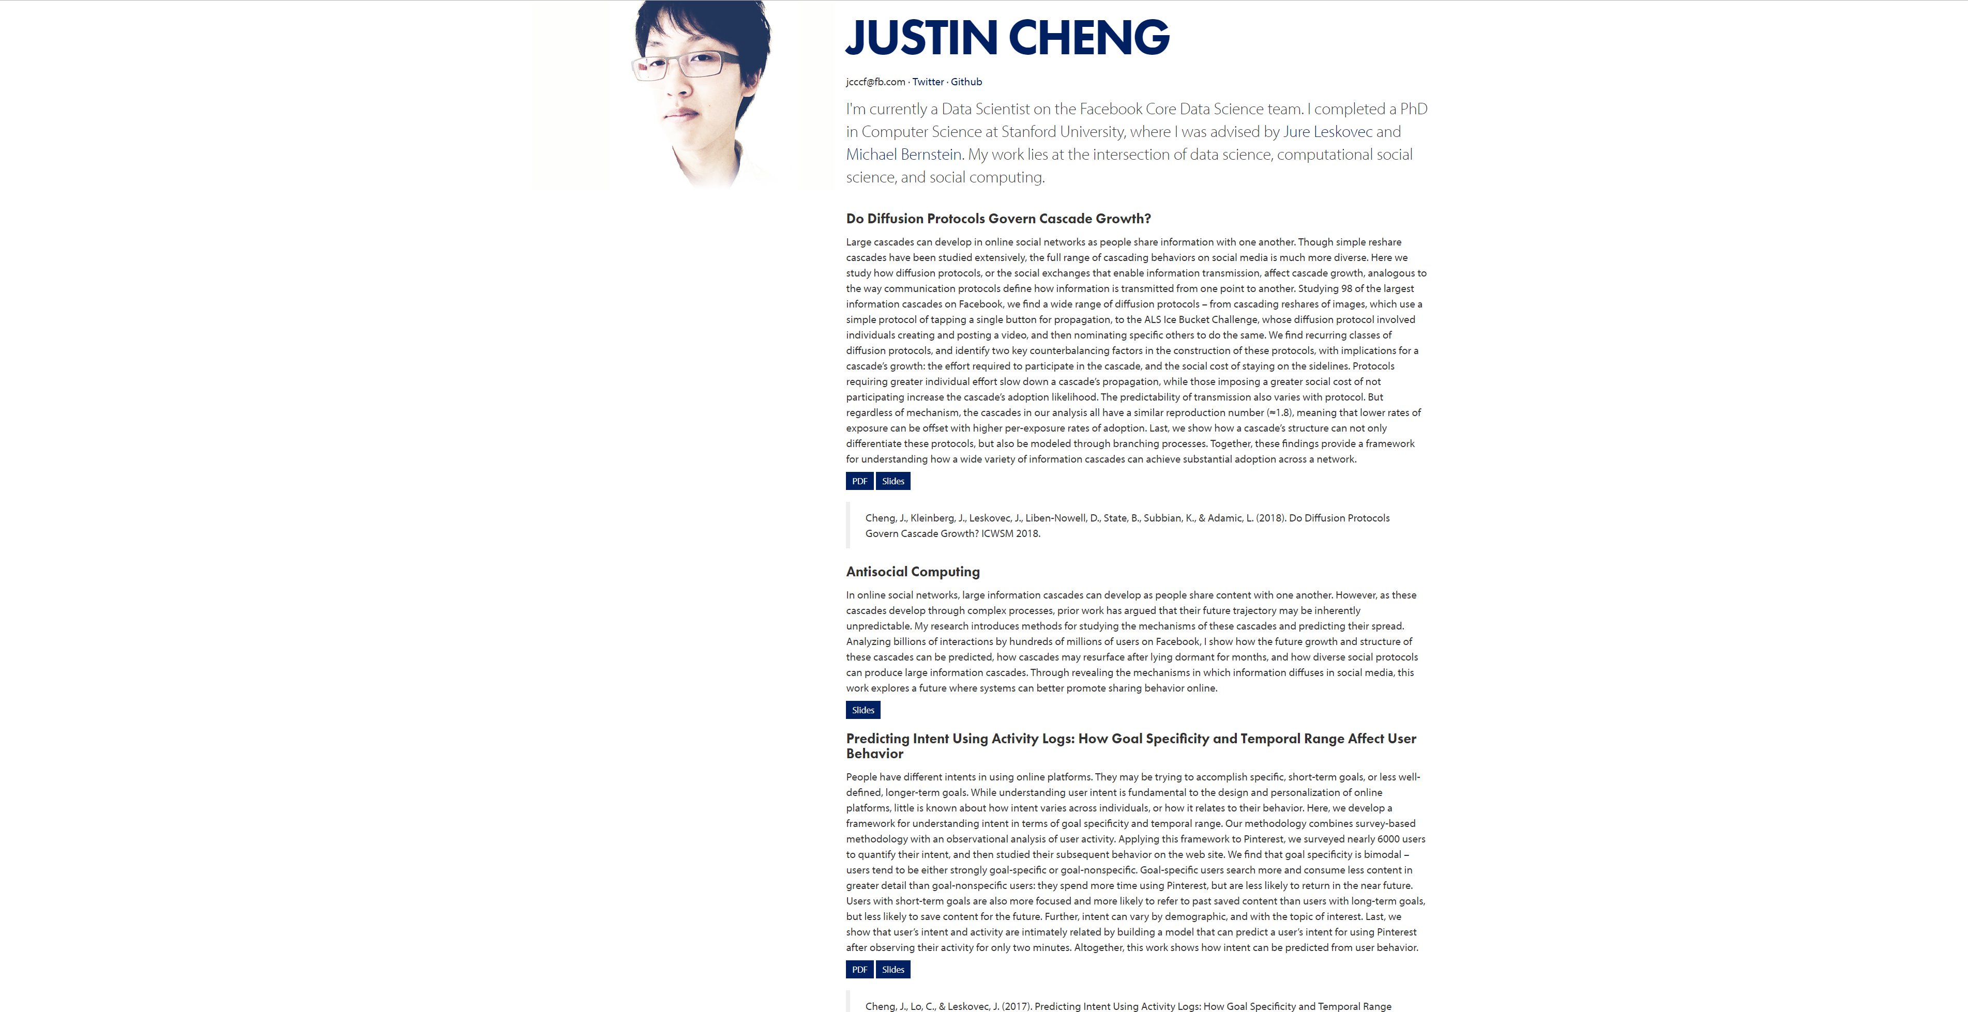
Notes:
https://www.clr3.com/

Slide 19
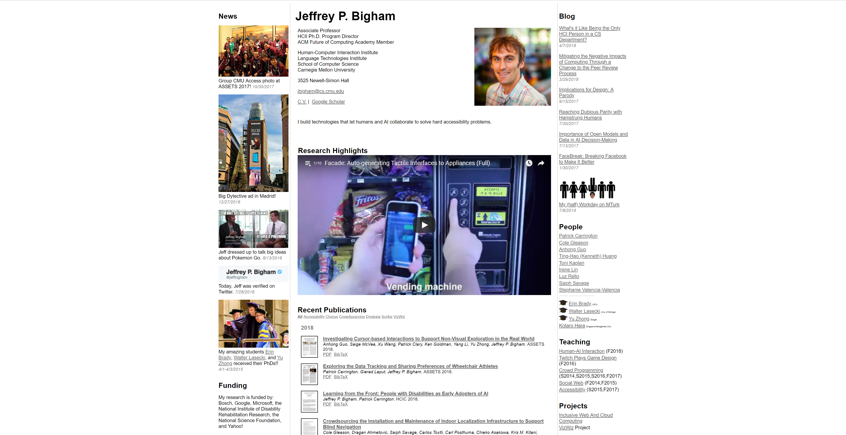
Notes:
https://www.cs.cmu.edu/~jbigham/

Slide 20
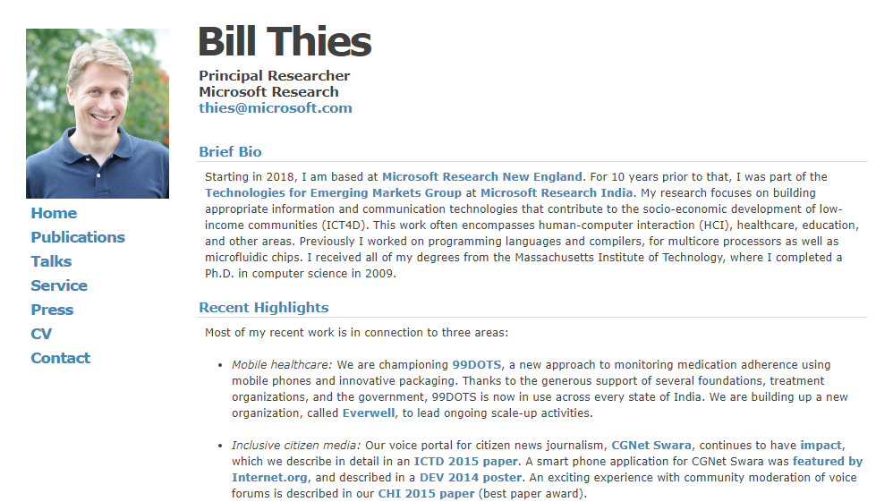

Slide 21
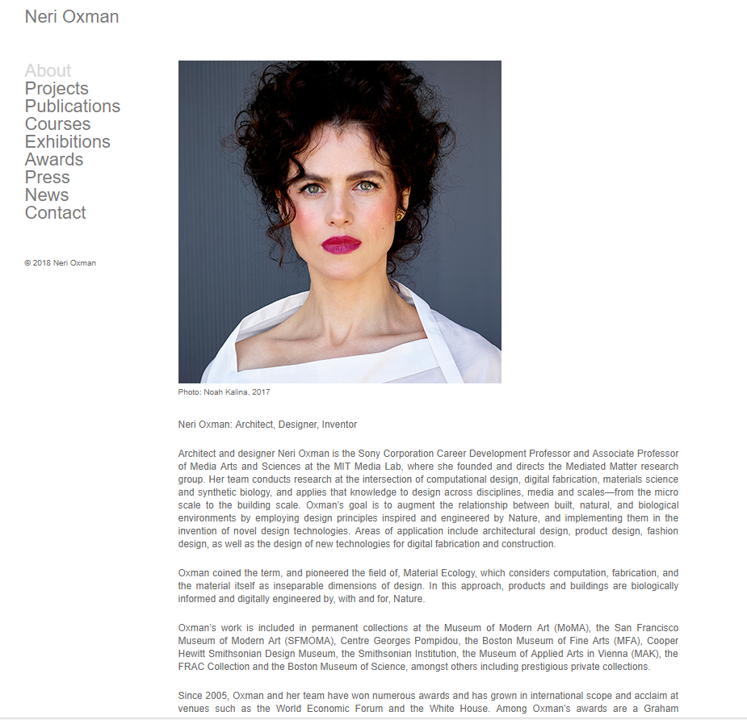

Slide 22
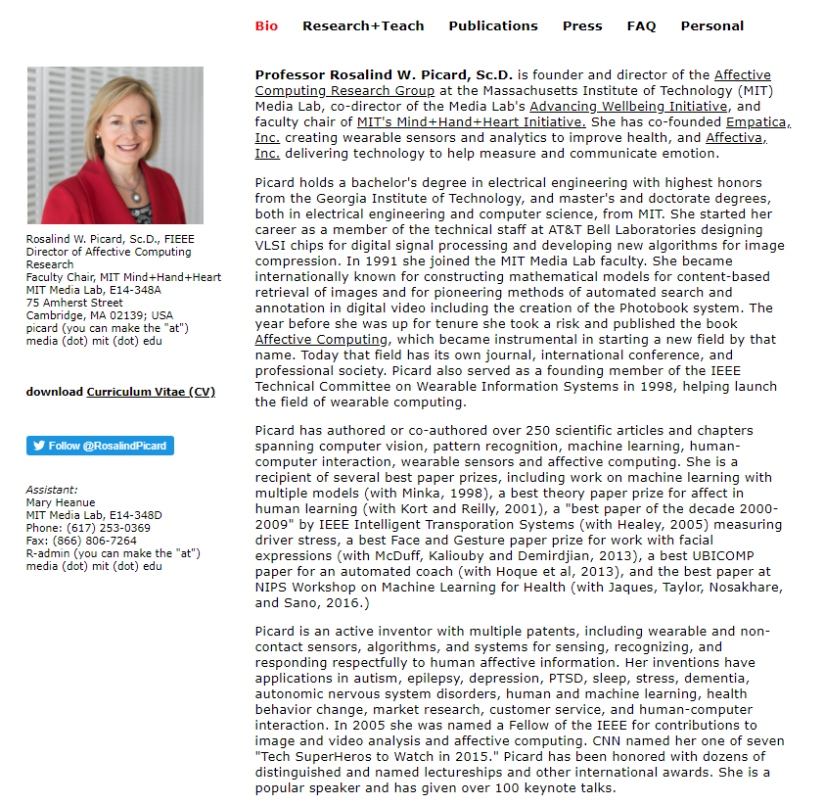

Slide 23

1

Slide 24
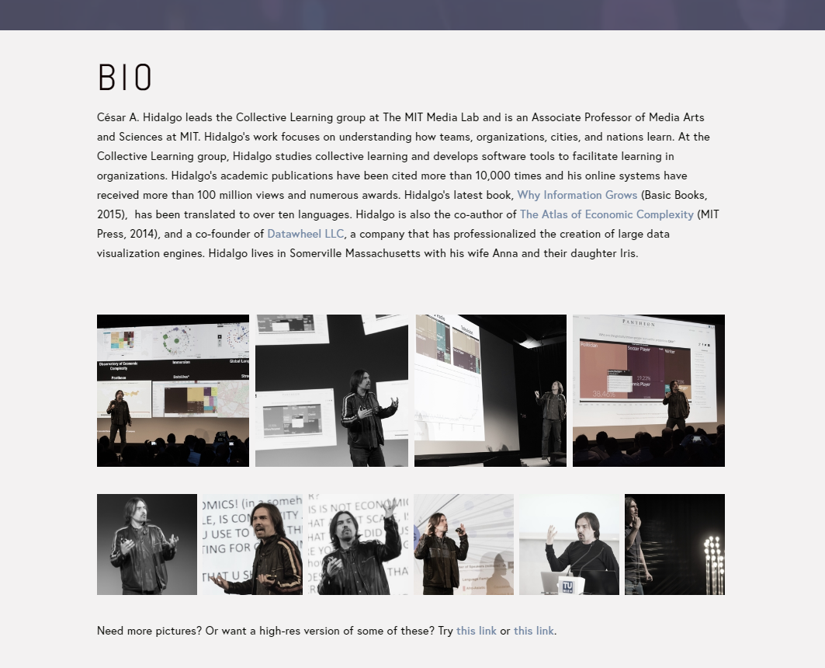
2

Slide 25
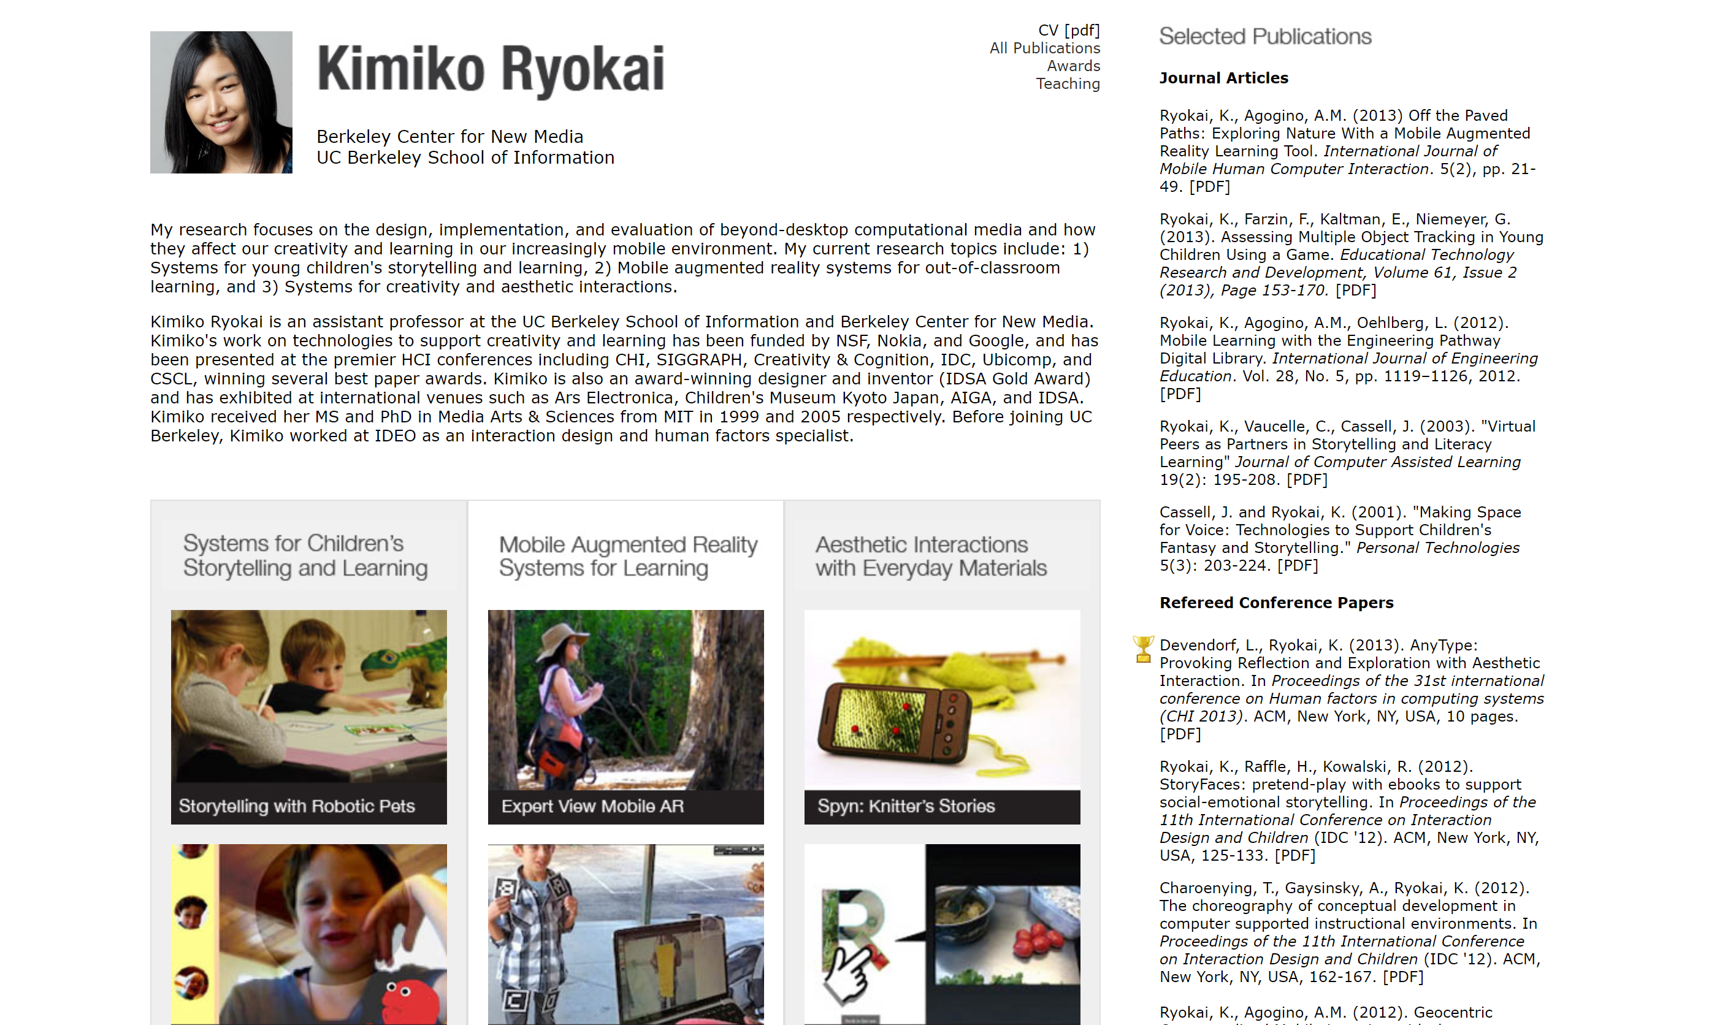

Slide 26


Slide 27
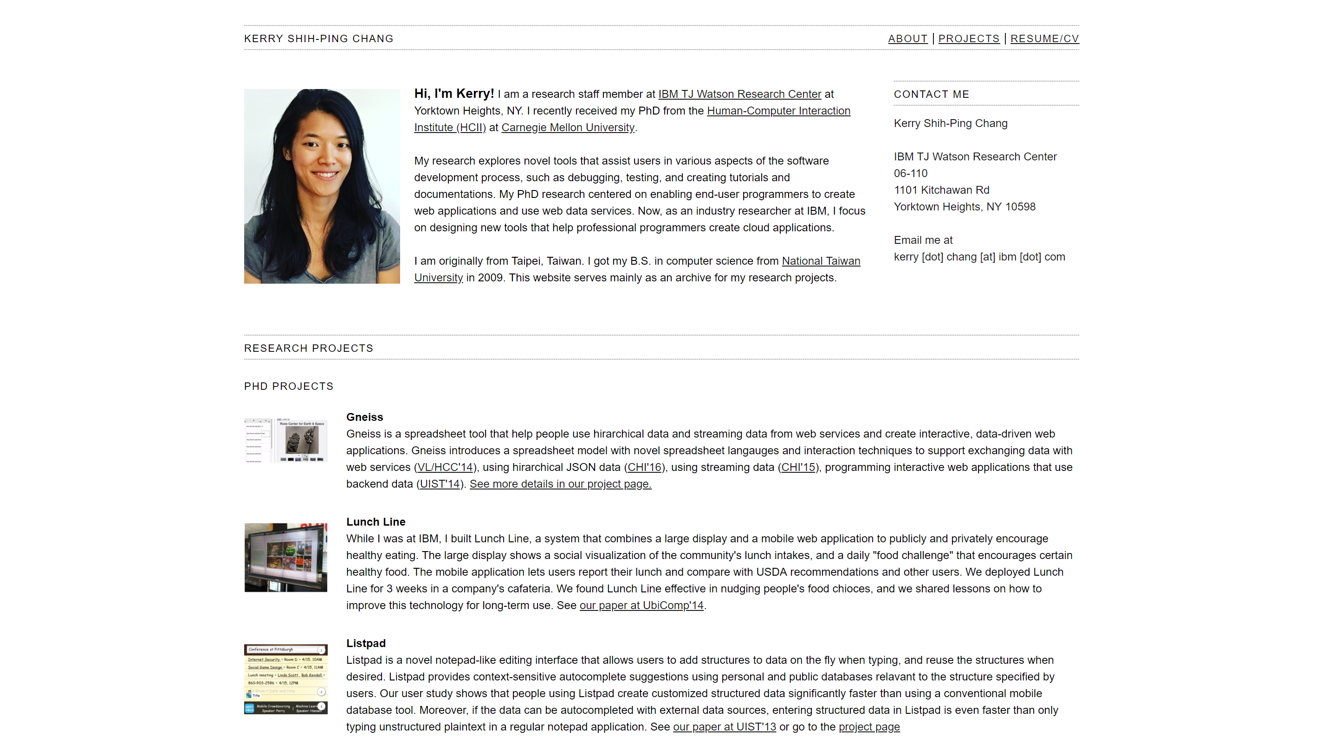

Slide 28
